Slide 1
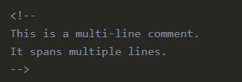
HTML Comments
Comments in HTML are like little notes you leave in your code for yourself or other people. These notes help make the code easier to understand but don't show up on the actual website. The web browser just skips over them.
Types of Comments in HTML
Single-line Comments
Multi-line Comments

